Slide 1
Data Analysis Portfolio Case Studies
Angela North
8/11/2023

Slide 2
Introduction
In this portfolio, I present case studies from various data analysis projects I've completed during my journey in the CareerFoundry Data Immersion program.
Each case study showcases my analytical skills, insights gained, and the impact of my work.
Through this portfolio, I aim to demonstrate my proficiency as a data analyst and my ability to derive actionable insights from real-world data.

Slide 3
Project 1 & 2: Preparing for Influenza Season
Goal
Help a medical staffing agency plan for the influenza season by analyzing trends and forecasting staffing needs.
Beginning:
Identified the need to proactively plan for staffing during influenza season.
Set the objective to analyze historical data and trends related to influenza cases.

Slide 4
Middle
Collected and analyzed influenza data to identify peak seasons and regions affected.
Utilized time series analysis to forecast staffing requirements based on past trends.
Explored correlations between influenza occurrences and other relevant variables.

Slide 5
End
Derived insights into peak influenza periods and regions with high demand for staffing.
Provided recommendations for allocating temporary medical workers to clinics and hospitals.
Enabled the agency to better prepare for staffing demands during influenza outbreaks.

Slide 6
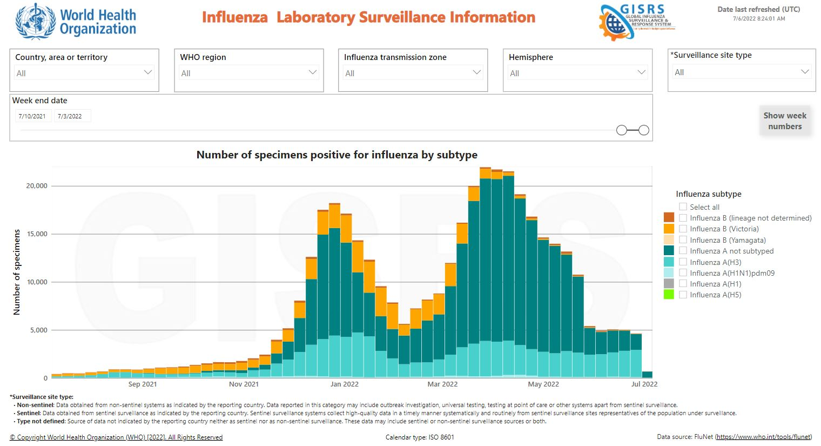
Historical Influenza Data Visualization

Slide 7
Project 3: Rockbuster Stealth Data Analysis
Goal
Assist Rockbuster Stealth in launching an online video rental service by analyzing customer behavior and preferences.
Beginning:
Tasked with helping the business intelligence department analyze Rockbuster's data.
Initiated data loading into a relational database management system.

Slide 8
Middle
Utilized SQL queries to analyze customer preferences, movie popularity, and revenue trends.
Created engaging visualizations to present insights to the management board.
Explored correlations between customer behavior and online video service success.

Slide 9
End
Provided valuable insights into customer preferences, enabling targeted content recommendations.
Assisted in shaping the launch strategy of the online video rental service.
Contributed to Rockbuster's competitive edge in the streaming market.

Slide 10
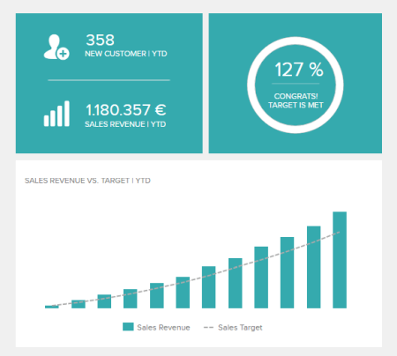
Revenue Trend Visualization

Slide 11
Project 4: Instacart Grocery Basket Analysis
Goal
Perform exploratory analysis for Instacart to uncover sales patterns and suggest strategies for customer segmentation.
Beginning
Engaged with Instacart's data to analyze sales patterns and customer behavior.
Aimed to identify trends and opportunities for targeted marketing campaigns.

Slide 12
Middle
Explored customer purchasing behavior, time-based trends, and popular product categories.
Utilized data mining techniques to segment customers based on behavior and loyalty.
Derived insights into peak shopping times and products that drive revenue.

Slide 13
End
Recommended targeted marketing strategies based on customer segments.
Identified prime time slots for product promotion to optimize sales.
Enabled Instacart to better understand customer preferences and tailor offerings.

Slide 14
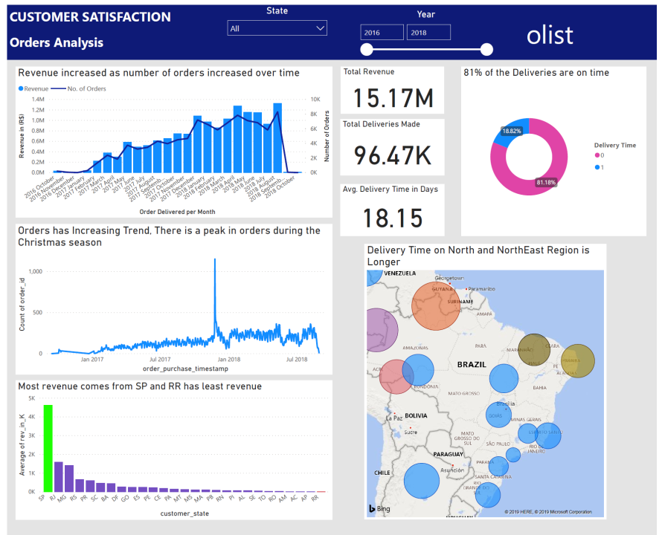
Customer Segmentation Visualization

Slide 15
Project 5: Data Ethics and Applied Analytics
Goal
Provided analytical support to a global bank's anti-money-laundering compliance department while navigating ethical challenges.
Beginning:
Joined the bank as a data analyst to assist with data-related compliance projects.
Set out to assess client risk, transaction risk, and optimize compliance processes.

Slide 16
Middle
Leveraged advanced data analytics to assess and mitigate money laundering risks.
Built predictive models to identify suspicious transactions and behaviors.
Addressed ethical dilemmas related to data privacy, bias, and transparency.

Slide 17
End
Enhanced the bank's compliance program efficiency and risk assessment accuracy.
Ensured compliance with data ethics, protecting customer information.
Empowered the bank to make informed decisions while upholding ethical standards.

Slide 18
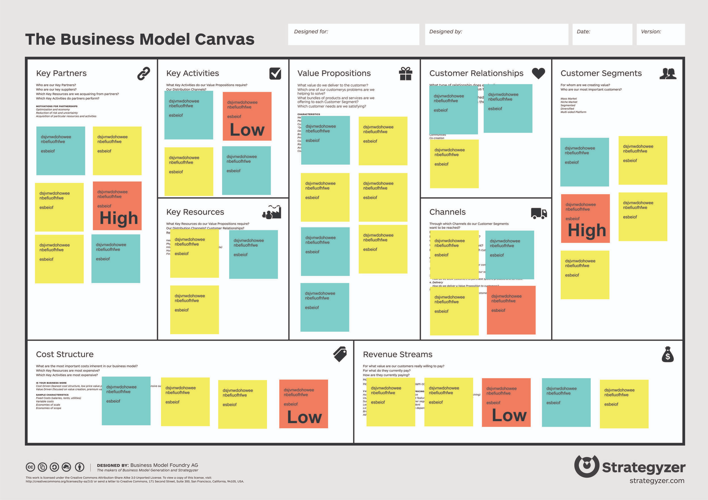
Risk Assessment Model Visualization

Slide 19
Portfolio Links
Github link
https://github.com/ango706/Python-Project
https://github.com/ango706/SQL-Project

Slide 20
Gun Violence In US Data Analysis
Introduction
Welcome to my Data Analytics Portfolio presentation.
In this journey, I will guide you through my exploration of gun violence data in the United States from 2013 to 2018.
Let's dive into the compelling story of how I leveraged advanced analytics and interactive visualization to uncover insights and trends.
Beginning: Understanding the Context
Gun violence is a critical issue in the United States, and I chose to analyze this dataset to gain deeper insights into its nature and patterns.
My goal was to use data analytics to shed light on this complex problem.

Slide 21
Middle: Exploratory Analysis and Hypotheses
I started by conducting an exploratory visual analysis using Python.
My initial hypotheses were:
Seasonal Patterns: Is there a noticeable pattern in gun violence incidents over the months?
Geographical Variation: Do certain states experience higher gun violence rates?
Type of Incident: Are there differences in trends between different types of gun violence incidents?
Advanced Analytics and Testing:
I employed various advanced analytics techniques:
Time Series Analysis: Unveiled seasonal patterns and trends in gun violence incidents.
Spatial Analysis: Mapped geographical hotspots using clustering techniques.
Statistical Testing: Tested hypotheses using hypothesis testing to validate assumptions.

Slide 22
Creating the Dashboard
I curated the most impactful insights into an interactive Tableau dashboard:
Temporal Trends: Line chart revealing monthly variations in gun violence incidents over the years.
Geographical Distribution: Heatmap showcasing concentrated areas of incidents.
Incident Types: Pie chart presenting the distribution of different types of gun violence incidents.

Slide 23
End: GitHub Repository and Conclusion
As my dashboard couldn't accommodate all my analyses, I documented additional insights, code, and visualizations in a GitHub repository linked in the dashboard.
Link to Tableau Storyboard:
Explore the interactive Tableau dashboard https://public.tableau.com/app/profile/angela.north
Link to GitHub Repository:
Access the GitHub repository with additional analyses here.
https://github.com/ango706/Advanced-Analytics-Dashboard-Design

Slide 24
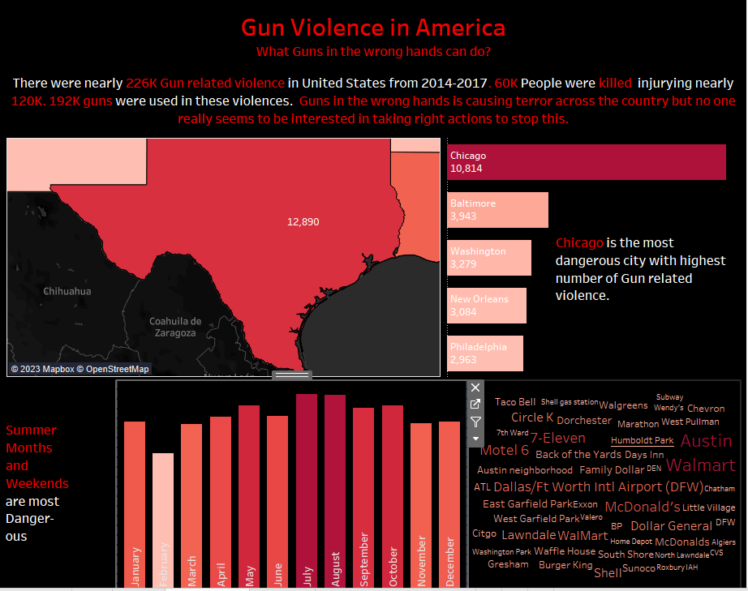
Gun Violence in America Dashboard

Slide 25
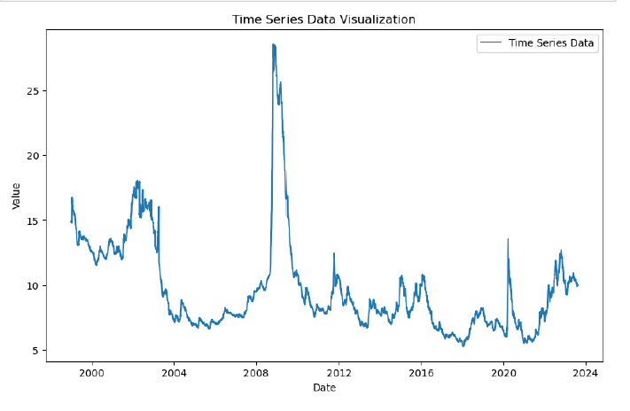
Time Series Data Visualization

Slide 26
Conclusion
Through this project, I've not only revealed insights into gun violence data but also showcased my skills in advanced analytics, data visualization, and storytelling.
Join me as we navigate the interactive dashboard and uncover the multifaceted dimensions of gun violence in the US.
Thank you for joining me on this data exploration journey.

Slide 27
Thank You
Thank you for taking the time to explore my portfolio and case studies.
I'm excited to share my journey in data analysis and the insights gained from these projects.
Feel free to reach out if you have any questions or would like to discuss my work further.
Email: angnorth24@gmail.com
GitHub: ango706

